Slide 1
CS383 - Enterprise Web Application Development
Module 1: Bootstrap
Part 03

Slide 2
Content
Headings
Lead
Inline text
Abbreviations (initialism)
Blockquotes
Lists
Responsive typography

Slide 3

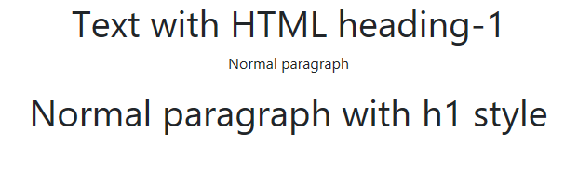
Headings
.h1 to .h6 if you want to use HTML headings styles without using HTML headings tags
Example:
Output:

Slide 4

Headings
SELF EXERCISE:
You can override the native HTML heading tags with bootstrap heading styles
Example:
But why would you do that?
Think of a scenario/situation where this can be useful. Otherwise why is it possible if it is not useful?

Slide 5
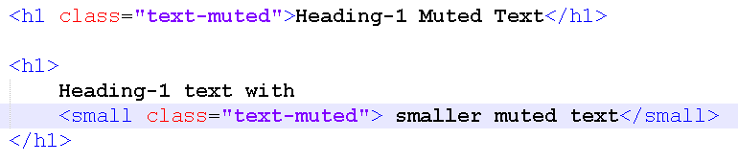

Headings Muted Text
Useful for creating smaller secondary heading text
Example:
Output:

Slide 6
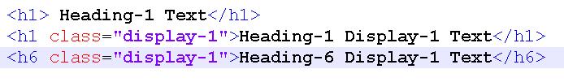

Headings Display
A larger, slightly more opinionated heading style
Example:
Output:

Slide 7
Headings Display
SELF EXERCISE:
We have 6 heading styles .h1 to .h6, how many display styles/classes we have in bootstrap 4.0 ?

Slide 8
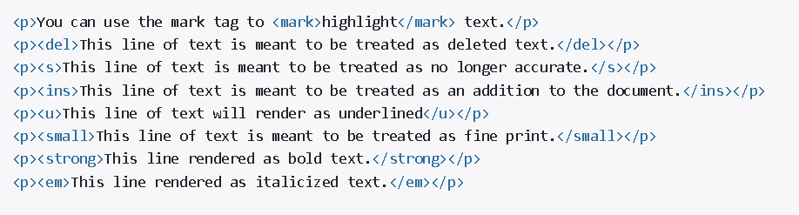
Inline text elements
Styling for common inline HTML5 elements
.mark and .small classes are also available to apply the same styles as <mark> and <small> while avoiding any unwanted semantic implications that the tags would bring

Slide 9
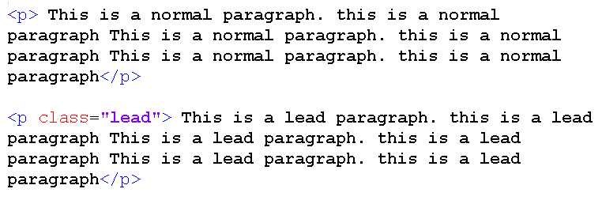
Lead
Use of class .lead to make a paragraph more noticeable.

Slide 10
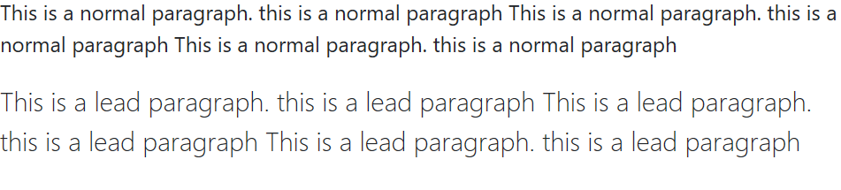
Lead
Output:

Slide 11
Abbreviations (initialism)
Stylized implementation of HTML’s <abbr> element for abbreviations and acronyms to show the expanded version on hover
Add .initialism to an abbreviation for a slightly smaller font-size.
Example:

Slide 12
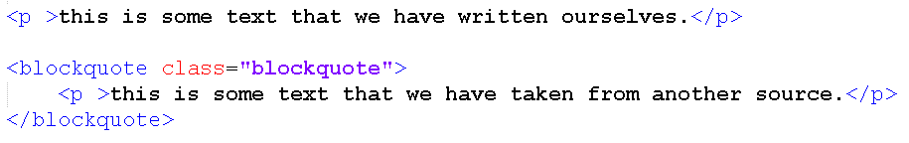

Blockquotes
Used for quoting blocks of content from another source
Example:
Output:

Slide 13
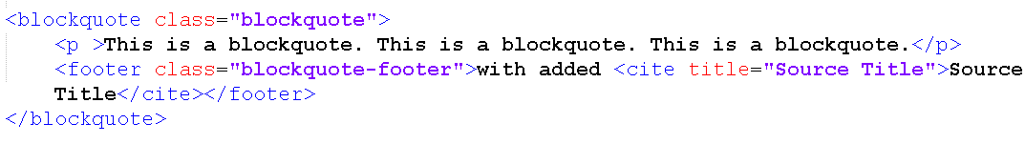

Blockquotes
To add the source name, use: <footer class="blockquote-footer">
Example:
Output:

Slide 14
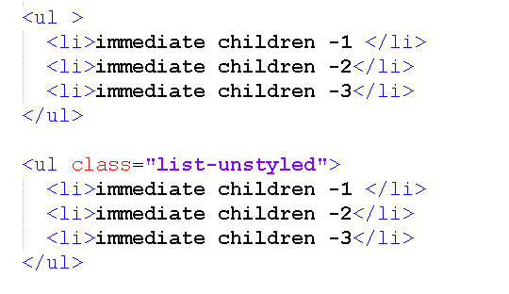
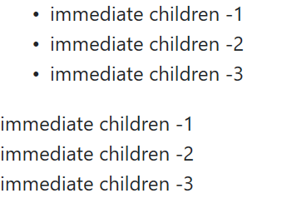
Lists
Unstyled : removing the default list-style using .list-unstyled
Example: Output:

Slide 15
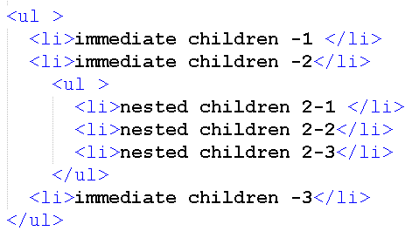
Lists
SELF EXERCISE
Does the .list-unstyled apply to nested lists?
Example:

Slide 16
Notes / Recommendations
Full tutorial on Typography with examples on: https://getbootstrap.com/docs/4.0/content/typography/
Offline copy of bootstrap/docs/Examples: https://getbootstrap.com/docs/4.0/examples/

